Slide 1
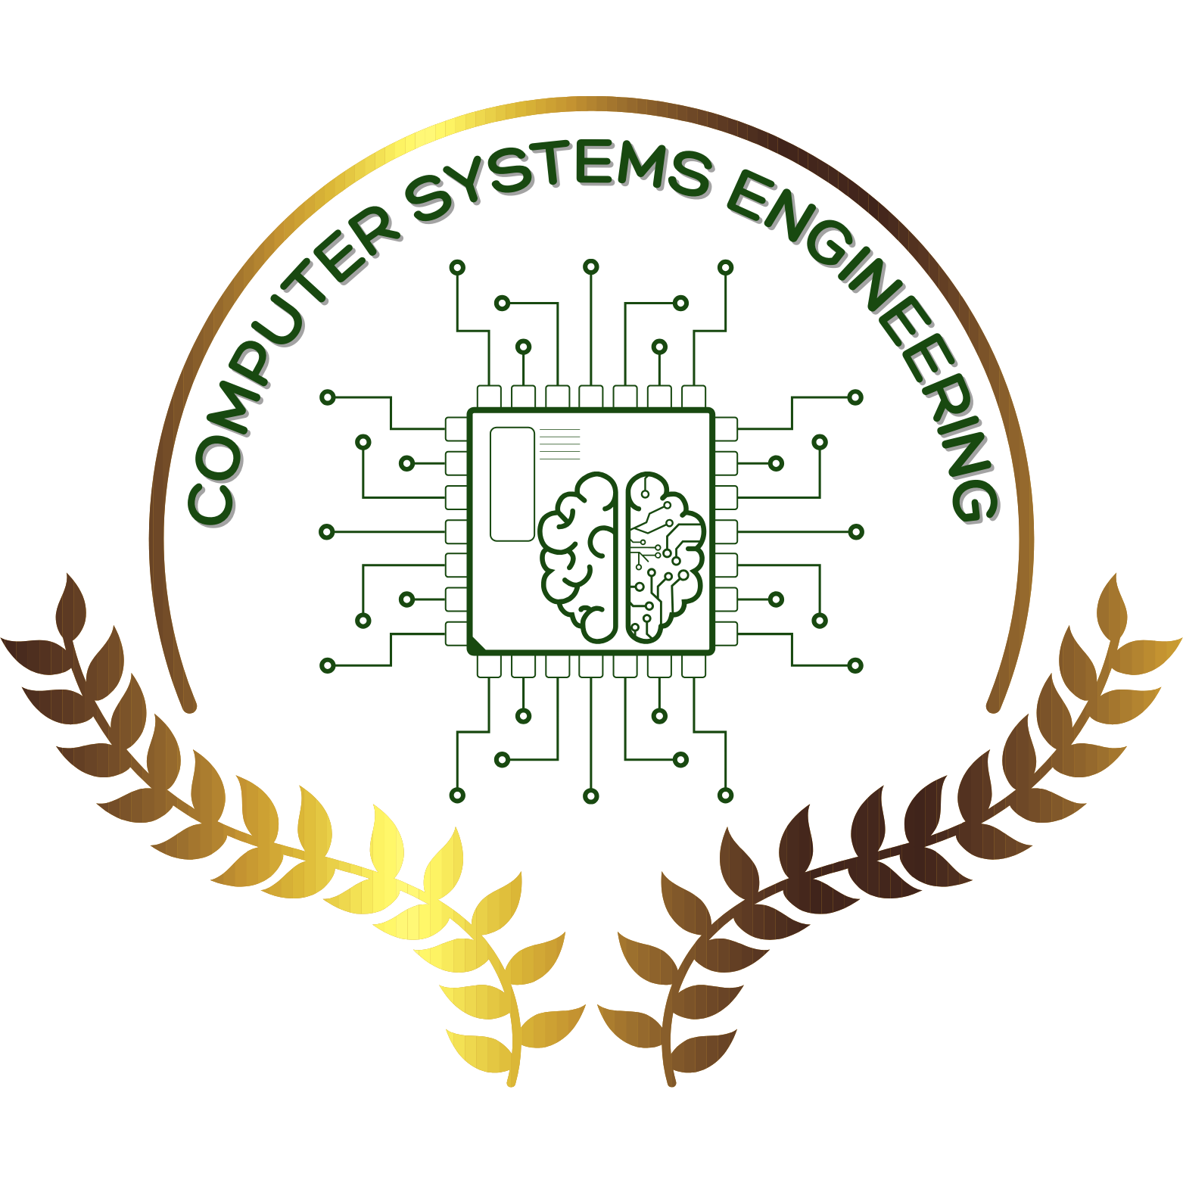
Hospital Management System
Student Name : Ali Emad 221395
Amr Hassan Abdel Moniem 246005
Abdelrahman waleed ahmed 232757
Mustafa mahmoud elsheny 243061
Abdulrahman Mohmaed Gaber 238383

Slide 2
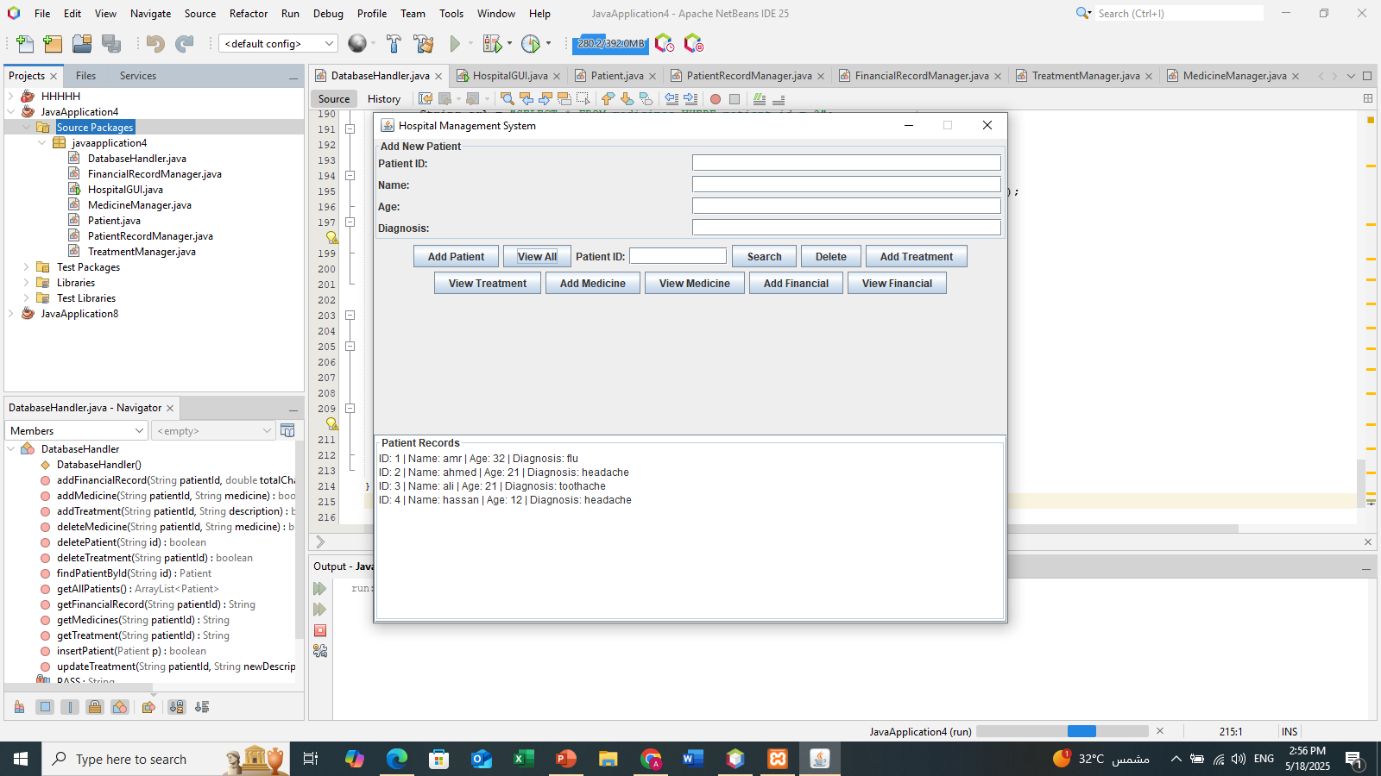
Hospital Management System (JAVA Project )
A Java-based desktop application developed to manage hospital records.
Built using Java programming language.
Includes database storage and a graphical user interface.

Slide 3
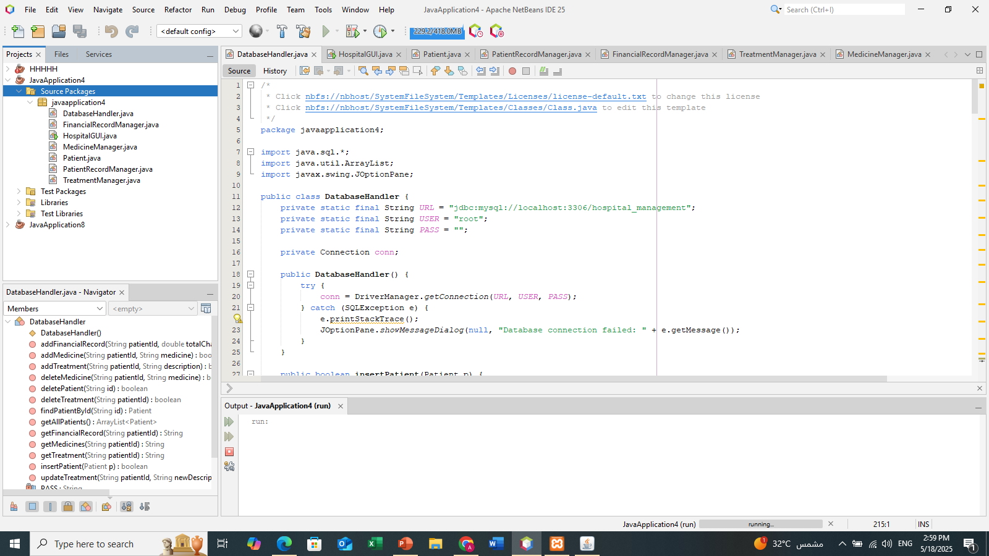
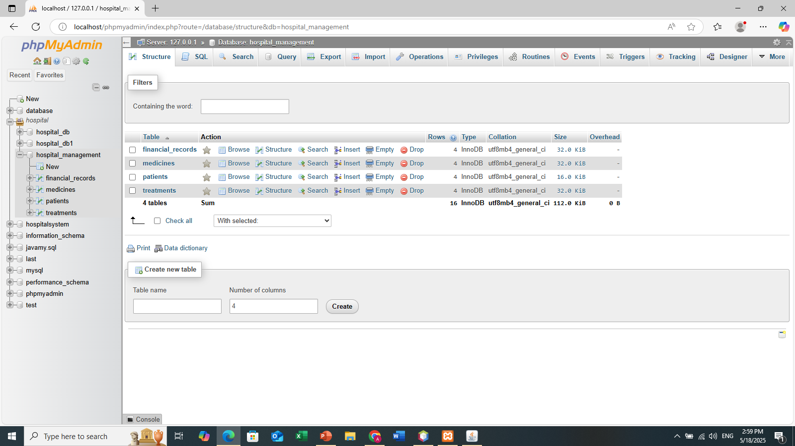
How is the application linked to the database?
This application is connected with a MySQL database.
Stores and retrieves hospital data (patients, treatments, finance, medicine)
Applies a conventional connection method to ensure reusability.

Slide 4
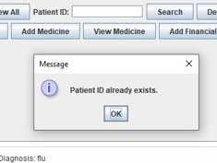
User data is stored in the system.
As the patient is register once , their information is stored in the system.
The ID cannot be entered twice.
It shows a message that the patient ID already exists.

Slide 5
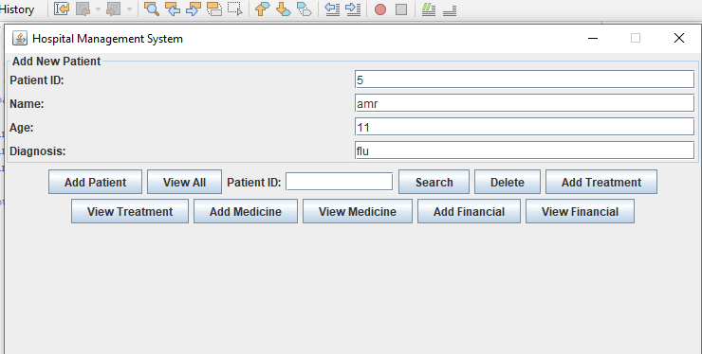
Creating the user interface
The interface is developed using Java.
It features components such as tables, buttons, text fields, and panels.
All elements are displayed within a single main application window.

Slide 6
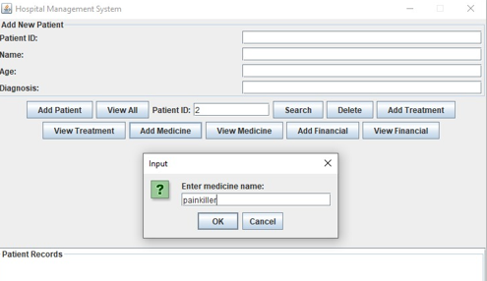
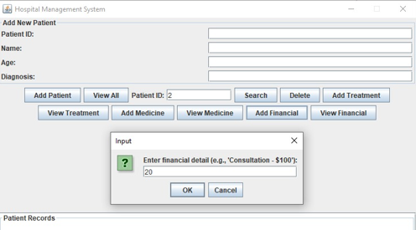
Enabling interactive features in the application
Users can add, search, or delete patients
Separate sections for treatments, medicines, and finances.
Each section interacts with the database or in-memory maps.

Slide 7
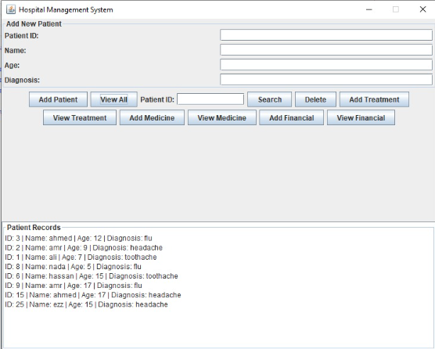
Add, Edit, Delete Records
Add patients with details.
View all saved patients in a list.
Edit or delete treatments, medicine, and financial records.

Slide 8
Cleanly organized and maintainable
Code is split into separate classes and responsibilities.
Classes: DatabaseHandler, GUI, Managers (Treatment, Finance, Medicine).
Makes the system scalable and easier to debug or update.

Slide 9
Summary
Full-featured hospital management app built in Java.
Combines user interface with database functionality.
Shows good modular structure and interactive features.

